Slide 1


Diffusing the culture of violence
“through Identity Affirmation”

Slide 2
Paradigms of Action
Provention
Prevention
Intervention
Prosecution
Execution

Slide 3
Origin and Obscuring of Alkebulani Identity
Alkebulan, Kush, Eden, Khenthunefer ancient indigenous names of (erstwhile) Africa from earliest time to 2nd Cent. BC. (Note: 0 degrees N. and 0 degrees E.)
Africa, from Scipio Africanus the Younger, defeated Carthage’s General, Hannibal Barca, 146 BC in Third Punic War after his father’s repeated loss in PW I and II.
Carthage (Qart- hadasht) became subject of Roman Empire and declined in prominence.

Slide 4
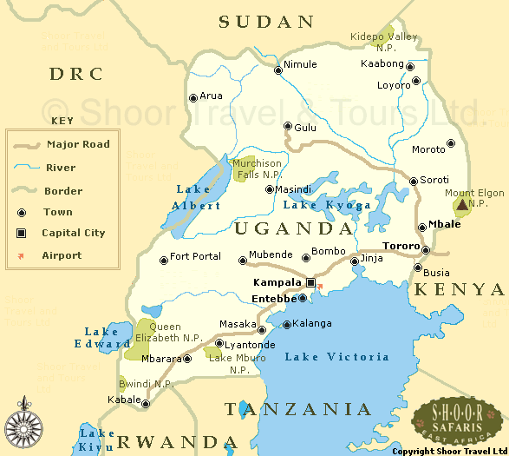

Slide 5
Uganda
From the Metu Neter (Words of God) the Name Uganda is telling!
U(r) : that which is first, chief ,and oldest
Gan: Tree or garden
Da: Hand
“The first, chief, and oldest tree of the garden taken by hand”
Cf. Genesis 3:1-6

Slide 6
Major Conquests of Alkebulan
1. Persian Conquest in 525 BC by Cambyses, son of Cyrus the Great beginning of foreign rule in ancient Egypt [Kemet]
2. Greek Conquest in 332 BC by Alexander, son of Phillip of Macedon and nursling of Lanike, foster brother of Clytus. Beginning of Ptolemaic Dynasty following his death cf. Dan. 8; 10; and 11.
3. Roman Conquest in 30 BC by Caesar, of Greek Empire, Roman influence supplants Greek.
4. Arab Conquests, 7th through 11th Centuries AD. Forced Islamization and first enslavement of Northeast, North, and West Africa. Early Medieval destruction of African culture/civilization.
5. European [Portuguese/Spanish] oppression and colonization of West Africa [Ngola, et al]. Beginning of Trans-Atlantic Slavery
Institutionalized by Papal bulls; augmenting Islamic enslavement.
6. Partitioning of Africa by 14 European nations (including the U.S.), 1884 Berlin Conference.

Slide 7
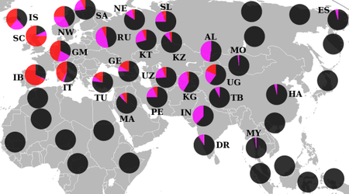
Genetic History of Iberian Peninsula
A number of studies focus on the genetic impact of the centuries of Muslim rule in the Iberian
Peninsula (Spring AD 711 to July 30 AD 1492) on the genetic make up of the modern Iberian population; it has the greatest presence of the typically Northwest African Y-chromosome haplotype marker E-M81 in Europe.^{[16][17]}and Haplotype Va.^{[18]} A thorough Y-chromosome analysis of the Iberian peninsula reveals that haplotype E-M81 surpasses frequencies of 10% in Southern Iberia

Slide 8
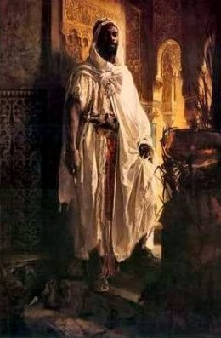
African Moors, Sephardi Jews 800 B.C., Christians AD 30, and Muslims AD 711 in Spain who introduced learning and civilization in Spain.
See Obadiah 20

Slide 9
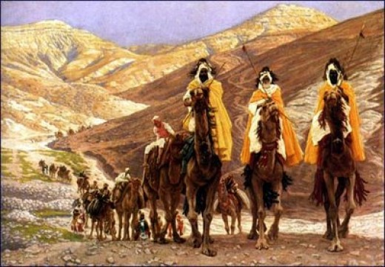
In the Spring of AD 711 Jabal Tarik bin Ziyad (Gibraltar) and his Black army swept up into Spain and defeated the Visigoths in successive stages - capturing and consolidating Spanish towns from the south including Toledo and Cordoba.

Slide 10
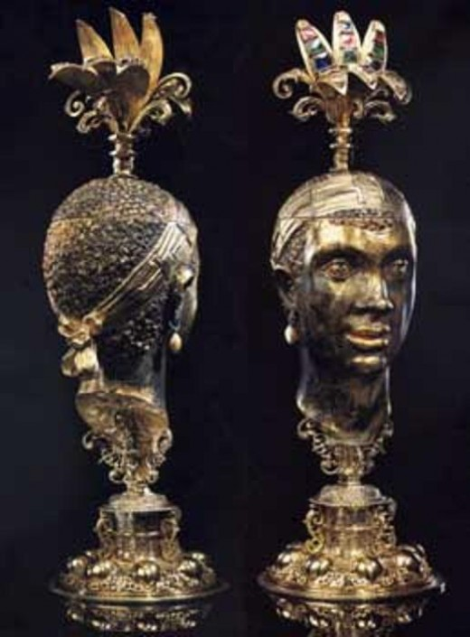
The Moors Head: The Ladino Moors. There is a history of the Jews of Cape Verde, the Guinea Rivers and Gulf of Biafra

Slide 11
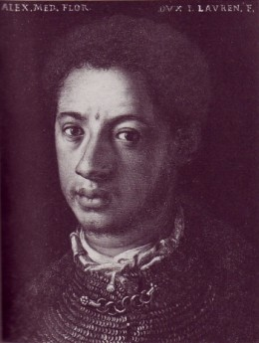
Alessandro de' Medici, called "Il Moro" (The Moor") was born in the Italian city of Urbino is 1510. His mother was an African slave named Dimonetta who had been freed

Slide 12
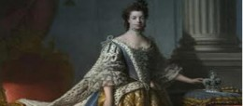
Queen Charlotte of Britain. Queen Charlotte Sophie of Mecklenburg Strelits (1744-1818) was wife of George III. she was described by others in her time as 'a true mulatto face', 'brown' or yellow.. Her nose was wide and her lips thick

Slide 13
Iberia is Iberian Ethiopia
Portugal and Spain called the Iberian Peninsula, a contraction of Iberian Ethiopia!
Ethiopia is the center of the ancient Antediluvian Empire of Atlantis, land of dark skinned people in East Alkebulan, the most advanced civilization known in the entire history of mankind.
Inhabited by Ethiopians, also called Iberians, later populated and intermixed with Europeans producing mulattos and hybrids of descending color castes (Castilians).
“How are we astonished when we reflect that to the Race of Negroes, at present our slaves, and the object of our extreme contempt we owe our arts and science and even the very use of Speech.” Count de Volney

Slide 14
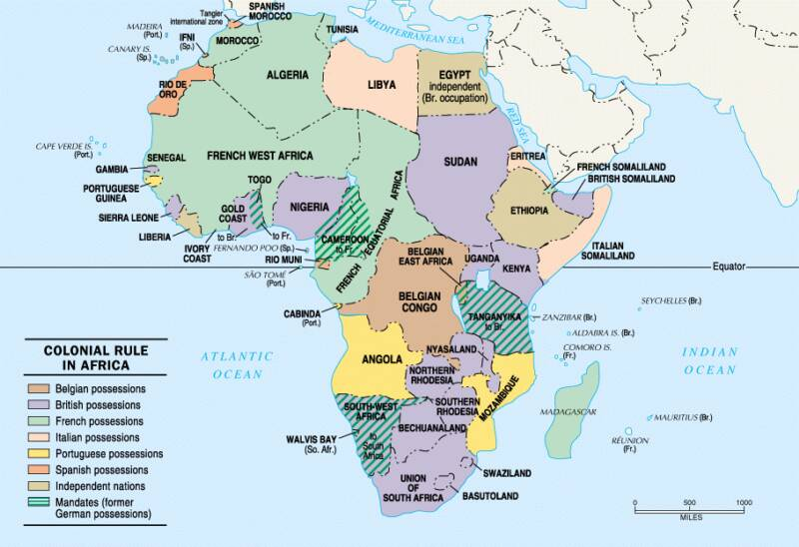
Berlin Conference Partitioning of Africa

Slide 15
Attendees of Berlin Conference
1. & 2.Austria-Hungary
3. Belgium
4. Denmark, 5. France, 6. Germany
7. Great Britain, 8. Italy, 9. The Netherlands, 10. Portugal
11. Russia, 12. Spain
13. Sweden-Norway (unified from 1814-1905)
14. The Ottoman Empire (Turkey)
The United States of America (did not physically attend)

Slide 16
Papal Bulls Instituting Slavery
Pope Eugenius IV March 3, 1431 to February 23, 1447
Creator Omnium January 17, 1434 (Canary Islands)
Sicut Dudum January 23, 1435 (Canary Islands)
Illius Qui 1442 Granted Portugal/Spain exclusive (enslavement) rights of commerce and conversion into Ngola, West Africa, et al
Note: The Hispanic was born in Africa [Ngola, etc.] and Hispaniola . . . Beginning ca. 1415 to 1600’s and is the child of African mothers. The language, Spanish, is that of the oppressor. The Spanish language is Arabic translated into Latin. Europeans are the 2nd successor enslavers to Islam.
Pope Felix V 1439 to 1449
Illius Qui 1442 Granted Portugal rights to enslave non- Catholic Canary Island inhabitants

Slide 17
Source of Violence Culture among African (and Latino) Males
Denigrate
De – reduce, opposite
ate to make, or cause
-nigr- god, king

Slide 18
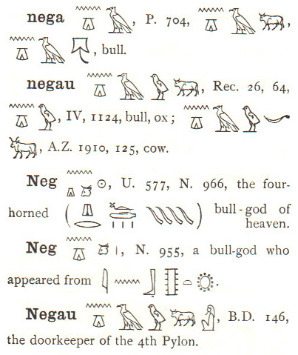
Original Script of Word

Slide 19
The Catalyst of the Culture
The essential nature of the social control structure of class societies; of racial oppression without reference to "phenotype" factors; of racial slavery in continental Anglo-America as a particular form of racial oppression; of the "white race"-- an all-class association of European-Americans held together by "racial" privileges conferred on laboring-class European-Americans relative to African-Americans -- as the principal historic guarantor of ruling-class domination of national life.

Slide 20
The Catalyst of the Culture
The Invention of the White Race (Vol. 1&2) T. W. Allen
In 1619 there were no “white” people in Virginia
After January 1677, in Virginia Colony, a new term appeared—white
Bacon’s Rebellion July 30, 1676 to January 1677
After 1680 the term “white “ as a race designation for Europeans based on skin complexion was used throughout the colonies, and by colonial law granted inequitable social and economic entitlements over and against Blacks, which found its way into the U.S. Constitution.

Slide 21
Transitioning to the Paradigm of Provention
1. Shift perception to “Youth in Chrysalis” rather than “At- risk youth”
2. Provent through Rites of Passage to Purpose rather than Occupation
3. Enlighten, Inform, and Inspire our youth with their factual history and generational identity
4. Empower our youth through knowledge of their Individual Economic Value: y = 20.2x

